Slide 1
Overview and Prevention of
Soccer Injuries
Peter Yeh, MD
Orthopaedic Surgeon, Sports Medicine
Excel Orthopaedic Specialists

Slide 2
Tonight’s Overview
Introduction
Most Common Soccer Injuries
Treatment of Injuries
Concussion
Strategies for Prevention

Slide 3
Introduction
Soccer, most widely played sports in both males/females
    About 265million registered around the world
US Youth Soccer registers >3 million players age 5-19
Since 1990, the number of HS soccer players have doubled
    Fastest growth of any sport
Females account for most of the rise, 210% in US, 250% in Switzerland, 160% in Germany in last 10 years

Slide 4
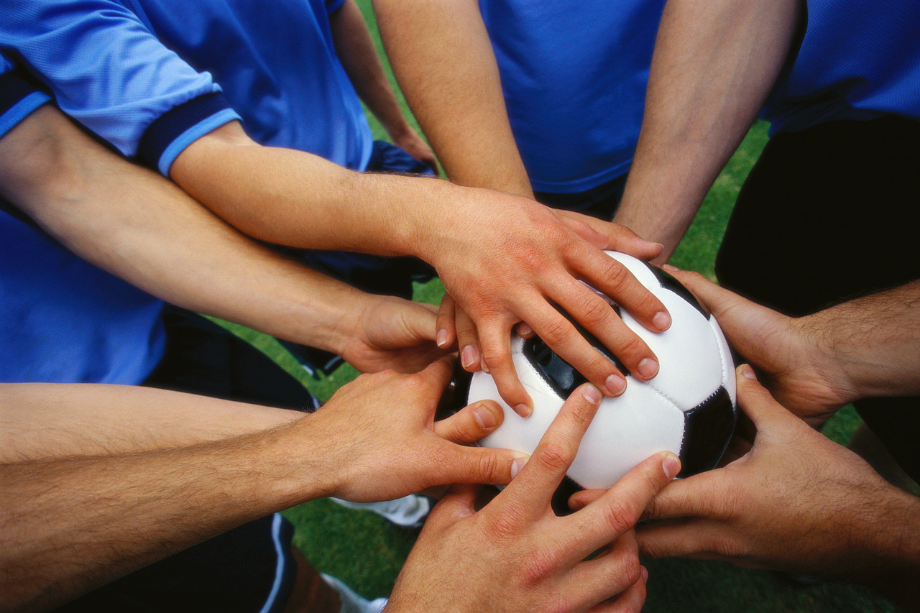
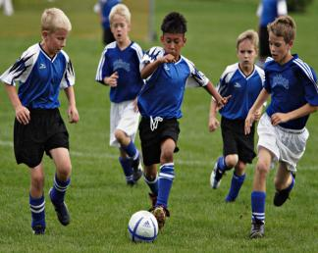
Soccer
Higher health-related quality of life
    Improved cardiovascular risk profiles
    Improved bone health
Increased self-esteem
Increased sense of community, national identity

Slide 5
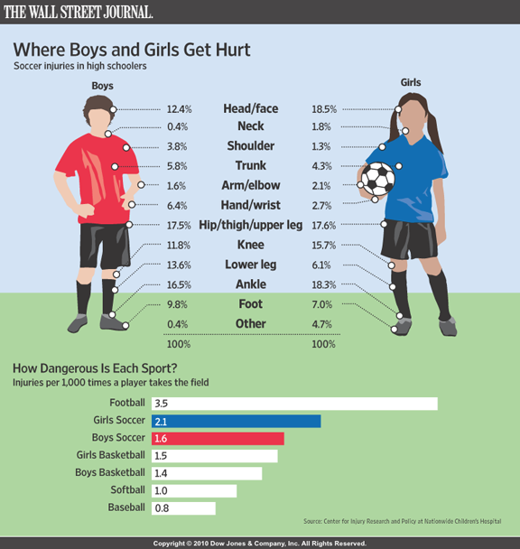
Soccer Injuries
Contact sport – risk of injury
    2.1 (male) vs. 1.6 (female) per 1,000 times HS player takes the field
Potentially quality-of-life altering
231,447 athletes treated in US Hospital ERs in 2012
High socioeconomic impact – US $30 billion
Wall Street Journal

Slide 6
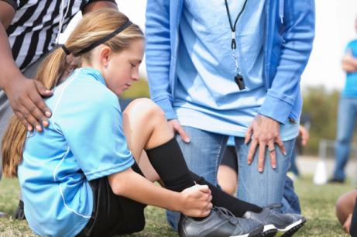
Soccer Injuries are Increasing
Participation in US Youth Soccer increased faster than the rate of injuries from 2000 to 2008
Participation decreased while estimated no. of injuries still increasing from 2008 to 2012
Injuries may not be just from an increase in participation
Males > Females in terms of number of injuries

Slide 7
US Emergency Visits due to Soccer Injuries 2000 – 2012
Esquivel et al – Sports Health 2015

Slide 8
Most Common Injuries
Lower extremity most common – About 77% of all injuries
  Acute
    Contusions most frequent
    Strains – muscle → hamstring and groin
    Sprains – ligaments → ankle and knees
      Ankle injuries tend to be more common, but depends on study
      Knee injuries tend to be more severe (>10 days of time loss)
      Most feared/concerning – knee injuries, especially ACL ruptures
  Chronic
    Shin splints, patellar and Achilles tendinitis, stress fractures

Slide 9
Less Common Injuries
Upper extremity injuries – fall on arm, player-player contact
  Wrist sprains, fractures, finger injuries, shoulder dislocations
Head, Neck and Face Injuries
  Cuts, bruises, facial fractures, neck sprains
  Concussion
    Female > Male
      Weaker neck muscles vs. underreported in males
      Women’s/Girls’ soccer concussion education significantly less
Referees also sustained similar types of injuries as players

Slide 10
Fractures
Fractures
  Comprise ~10% of all soccer injuries
    Of all sports, soccer is the most common to sustain a fracture
  Upper Extremity
    More common than lower extremity fractures (2x)
    Finger Phalanx 30%, Wrist 29% → goals, falls
  Lower Extremity
    More likely to result in surgery and time lost
    Ankle 42%, Metatarsals 20% → tackles
Lower leg and wrist fractures have ⬇decreased
  Attributed to use of shin guards and better shoes/cleats
High rate of return (>90%) return to sport
  Those who did not were for fear and personal reasons (>90%)
  Persisting symptoms were not reasons for staying out
Robertson et al AJSM 2012

Slide 11
Factors to Consider
Human Factors
Equipment Factors
Environmental Factors
Biomechanical and Neuromuscular Factors

Slide 12
Human Factors
Age
  Older players (> 30 years) – greater # of injuries
Gender
  Shoulder injuries – Males > Females
  Males injuries – player-player contact
  Females injuries – Noncontact, with surface
    More prone to ACL injuries
  Males – (2x) more likely to be hospitalized
    Fractures more common in males
    40-49 yo → (5x) more likely to be hospitalized
  Females may be more likely to suffer concussion than males
  Females have greater muscle imbalances (ie lateral calf > medial calf → Achilles tendinitis)

Slide 13
Human Factors
Level of Play
  High level competition: Hamstring strains most reported, most time loss
    Fractures more common
  Low level competition: Lateral ankle sprain
Player position
  Strikers, Defenders more often in amateur leagues
  Midfielders in WUSA and Men’s Spanish league study
    Defenders > Forwards > Goalkeepers
Timing of Injury
  3-4x more common in games vs. practices
    In game – player to player contact
    Practice – non-contact
  Most occurred in last quarter of 2nd half
    Neuromuscular fatigue?

Slide 14
Equipment Factors
Bracing
  Ankle bracing has been shown to ⬇injury, ?severity
  No studies have statistically shown knee bracing ⬇ the number and severity of injuries
Footwear
  Shoes that ⬆friction may improve performance, but…
    May ⬆ligamentous injuries
    More rigid soles tend to have ⬆rotational stiffness leading to injury
    Screw-in cleats tend to lead to more injury than molded / ribbed soles
    ⬆ #cleats and shorter cleats safer

Slide 15
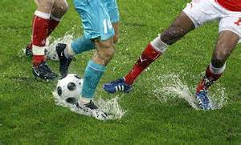
Environmental Factors
Playing Surface / Field Conditions
  No significant overall difference between indoor and outdoor
  Artificial turf tend to lead to more injury
    Shoulder injuries 2x higher on artificial turf vs. grass
    ⬆ACL injuries on turf vs natural grass
  Artificial turf - ⬆skin infections, ⬆temp
  Goalposts – Mobile? Padded?
    Have lead to fatalities!
Weather
  Cold tended to yield lower ACL and ankle sprain injuries (NFL study)
    Lower friction between shoes and surface

Slide 16
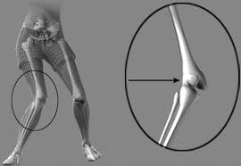
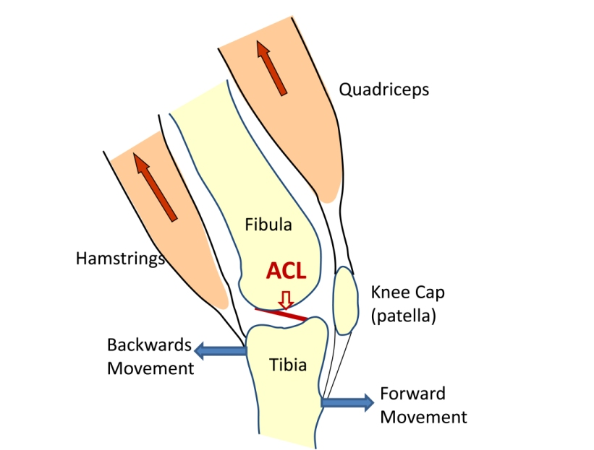
Biomechanical / Neuromuscular Risk Factors
Inadequate warm-up and muscle training
Excessive load-bearing, extreme torsional forces
Hamstrings help to provide anterior knee stability
Females typically with greater quadriceps and decreased hamstrings activity
    Less knee flexion and greater knee valgus when landing or cutting ⬆strain
    on ACL leading to ruptures

Slide 17
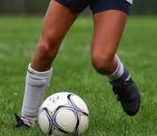
ACL Injuries
70% ACL tears are non-contact
Usually from a one-step stop deceleration, cutting, sudden change in direction or landing from a jump with inadequate knee and hip flexion
ACL sees most strain when
    hip flexed, abducted
    foot pronated
    tibia internally rotated, knee in valgus and near full extension
    → athlete attempts to change direction
ACL ruptures more in non-kicking leg

Slide 18
Treatment of Soccer Injuries
Stop play until injury is evaluated and treated by a health professional
Most injuries are minor
    Short period of rest, ice and elevation
Return to play when clearance is granted by health professional
    Joint is:
      Full ROM, normal strength
      No swelling
      No pain

Slide 19
Treatment of ACL Injuries
Surgical reconstruction is usually required
  Take own tissue as graft (patellar tendon, hamstring, quadriceps)
  Done via small incisions (arthroscopically assisted)
  Recovery is the hard part
    Usually 6 months to 1 year
Non-operative treatment has a minimal role
  PT and custom bracing

Slide 20
Concussion
Definition: Any alteration in an athlete's mental state due to head trauma
The athlete does NOT have to lose consciousness
Study by FIFA showed head injuries caused by arm on another
player or heading; most from challenges in the air
Can lead to:
  Post-Concussion Syndrome – Short Term
  Chronic Traumatic Encephalopathy – Long Term
Second Impact Syndrome – another head blow while recovering
  Neurovascular event leading to brain swelling
  Leads to potential death
  Reason why concussed athletes DO NOT CONTINUE PLAY

Slide 21
Concussion Symptoms
Balance Problems
Difficulty communicating, concentrating
Dizziness
Drowsiness
Fatigue
Feeling emotional
Feeling mentally foggy
Headache
Irritability
Memory difficulties
Nausea
Nervousness
Numbness or tingling
Sadness
Sensitivity to light or noise
Sleeping more than usual or difficulty falling asleep
Visual problems – blurry or double vision
Vomiting

Slide 22
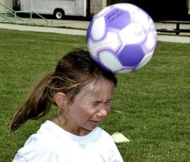
Concussion Treatment
Athlete MUST come out of play and be evaluated by a medical professional
    Address any deficits, supportive treatment
No return to play until completely symptom free at rest and with exercise
    ImPACT testing – neurocognitive test
    No definitive blood or imaging test to clear
    Clearance by a medical professional

Slide 23
Strategies for Prevention
Have a pre-season physical exam and follow recommendations – i.e. Excel Orthopaedics – Move2Perform
Use appropriate equipment
    Cleats (shorter, multi, molded) to minimize forces
    Shin guards – need to be individually fitted to cover lower leg to protect against fractures, contusions, abrasions
    Taping / Brace – after an ankle sprain as it can help from re-injury
    Goalkeepers – wear padded uniforms and gloves to protect hips, elbows, shoulders, knees and hands/wrists
    Pad the goalposts

Slide 24
Strategies for Prevention
Be aware of poor field conditions – inspect the field for holes
Use properly sized synthetic, nonabsorbent balls, i.e. leather balls can become waterlogged and heavy – dangerous for heading
Watch out for mobile goals – may fall; request fixed goals
  Pad the goalposts!

Slide 25
Strategies for Prevention
Hydrate adequately – waiting until thirst is too late
  Pay attention to environmental conditions – hot/humid
    Outdoor artificial turf tends to create hotter conditions
  In general – 24oz of non-caffeinated fluid 2hrs before exercise
    Additional 8oz of water/sports drink right before exercise
    During breaks, 8oz cup of water every 20 minutes
Warm up and stretch – hips, knees, thighs and calves; cold muscles more prone to injury
  Warm up with jumping jacks, stationary cycling, running/walking for 3-5 min
  Slowly and gently stretch, holding each stretch for 30 seconds
Cool down and stretch – just as important post-exercise; help reduce muscle soreness

Slide 26
Strategies for Prevention
Maintain proper fitness – injuries rate higher who have not prepared
  After inactivity, progress gradually back via aerobics, strength and agility training
  During off-season, stick to balanced fitness program incorporating aerobic exercise, strength training and flexibility
Avoid overuse injuries
  Listen to your body! → cut back if pain or discomfort develops
  Joint swelling (i.e. knee, ankle) should NOT be ignored – see a health professional
  Many believe it to be beneficial to take at least one season off each year

Slide 27
Strategies for Prevention
Neuromuscular training program
  6 week intervention of stretching, plyometrics, weight training emphasizing on proper alignment and technique
  Balancing / Proprioception shown to decrease muscle and ACL injuries – floor exercises, wobble board, balance mat
  6-8 weeks training needed before effect seen
  Decrease injury by 2.4-3.6x compared to untrained group
  Implemented into “11+ prevention program” by FIFA
  Have been shown to ⬇other injuries, especially in female athletes

Slide 28
Strategies for Prevention Concussion
Develop protocols for concussion education and management
  Football (97%)
  Hockey (65%)
  Men’s and Women’s Soccer (57, 47%)
Purposeful heading should be discouraged in children under 10
  Consider not heading at all until at least high school
Total commitment to fair play
Consider baseline ImPACT testing prior to season
At Excel Orthopaedics, will be able to facilitate ImPACT testing – Gregory Crossman (Excel PT)

Slide 29
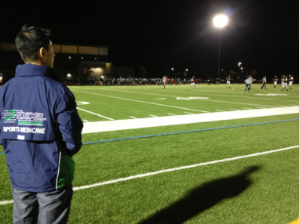
Thank You!
Questions?
Excel Orthopaedic Specialists
200 Unicorn Park Drive
Woburn MA 01801
781-782-1300
www.excelortho.com

